Slide 1
FHIR The Basics (and beyond)
Ewout Kramer
March 14, 2013

Slide 2
This presentation
Can be downloaded here (user ‘anonymous’, no password):
http://gforge.hl7.org/svn/fhir/trunk/presentations/HL7 UK FHIR The Basics.pptx
Is licensed for use under the Creative Commons, specifically:
Creative Commons Attribution 3.0 Unported License
(Do with it as you wish, so long as you give credit)
Based on Lloyds WGM tutorial

Slide 3
Who am I?
Name: Ewout Kramer
Company: Furore (Amsterdam, NL)
Background:
Initial participant in FHIR core team
Member of the HL7 RIMBAA group
Involved in software development of v3 based systems

Slide 4
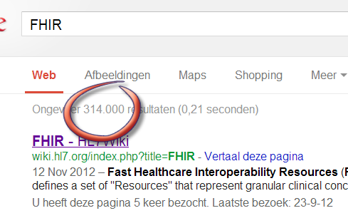
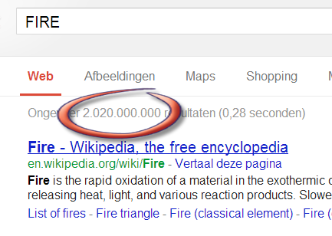
Fast
Healthcare
Interoperability
Resources

Slide 5
The Need
“How can I get data from my server to my iOS app?”
“How do I connect my applications using cloud storage?”
“How can I give record-based standardized access to my PHR?”
Notes:
They probably craft something themselves
We want HL7 to have an answer to these.
If we don’t => someone else will do it and we will lose credibility.
You could do it using v3, but not solely based on the downloadable UV-version. And probably not on some country-specific Implementation Guide either (different focus, priorities)

Slide 6

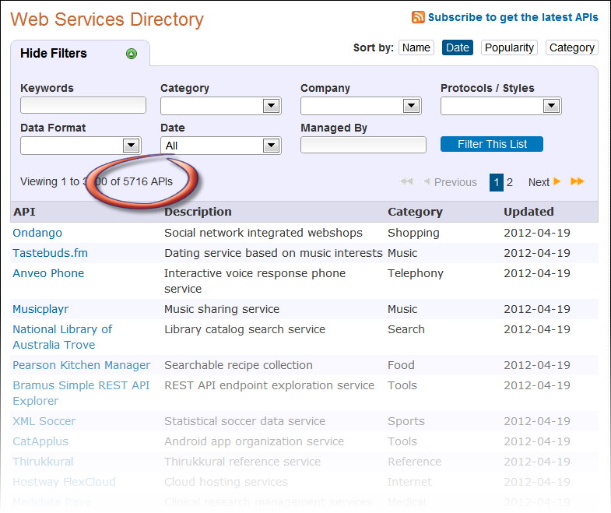
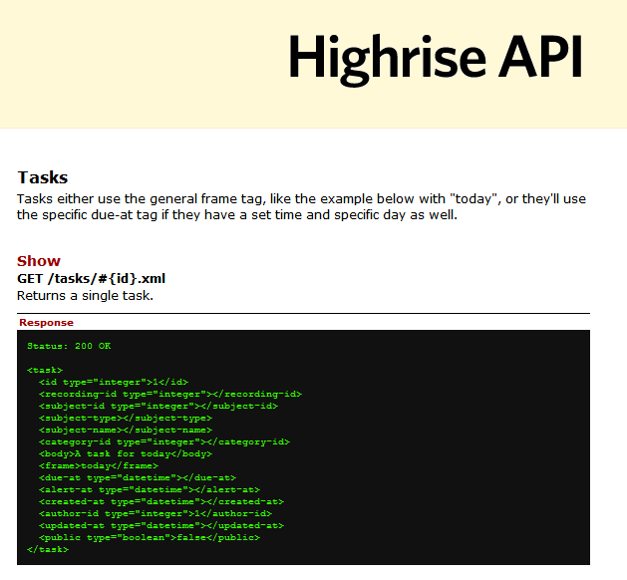
Highrise

Slide 7
V3 is too hard?
V3 puts the modeler before the implementer
Learning curve is too steep
Not easily adopted by out-of-box tools
Caught up in the need to do everything
Internationally defined specifications are not directly implementable

Slide 8



January 2011 The HL7 Board initiated
“Fresh Look”
“What would we do if we were to revisit the healthcare interoperability space from scratch?”
Grahame Grieve
Lloyd McKenzie
Ewout Kramer

Slide 9
FHIR Principles

Slide 10
FHIR Manifesto
Focus on implementers
Keep common scenarios simple
Leverage existing technologies
Provide human readability
Make content freely available
Demonstrate best practice governance
Notes:
We don’t actually have a formal manifesto, but these are the principles we adhere to.

Slide 11
Implementer Focus
Specification is written for target audience: implementers
Publicly available test servers
Starter APIs published with spec (Java, C#, …)
Connectathons to verify specification approaches
Lots of examples (and they’re valid too)
Notes:
Who’s read the v3 spec? – modeler & balloter focused
Spec is driven by people who write code
Numerous pieces have been changed because of experience with what worked when trying to implement
Even have a test workbench for RESTful servers

Slide 12
Keep it simple
You should be able to “figure it out” over a weekend.
Easy to get started, grow into the spec for more complex scenario’s
Don’t try to cover all: inclusion of content in core specification is based on “80% of implementers” rule
“Drive by interoperability”
Notes:
“Only include data elements in the artifacts if 80% of all implementers of that artifact will use the data element”

Slide 13
Existing technologies
XML, Json, ATOM
UML class diagram, eCore
Xsd, Schematron
REST API like
Facebook & Twitter
HTTPS, OAuth
NoSql, Amazon S3, Lucene
Notes:
We try very hard to *not* invent stuff that exists elsewhere unless it’s really broken or totally unaligned with the FHIR principles.

Slide 14
Governance
Oversight
TSC
Governance
FGB
Methodology
MnM
Management
FMG
Content
Core Team
Content
Work Groups
Notes:
FHIR Governance Board
Maintains FHIR principles
Identifies risks, precepts
Handles coordination w/ external groups
FHIR Management Group
Coordinates Work Groups
Manages ballot process
Education delivery
Day-to-day activities
Modeling & Methodology
Defines criteria for artifacts
Determines processes
Documents best practices
Work Groups
Do the actual development work
Core Team
Temporary
Takes on work Work Groups can’t
Expedites
What haven’t we talked about yet?

Slide 15
WHAT’s IN THE BOX?
Notes:
9:45

Slide 16
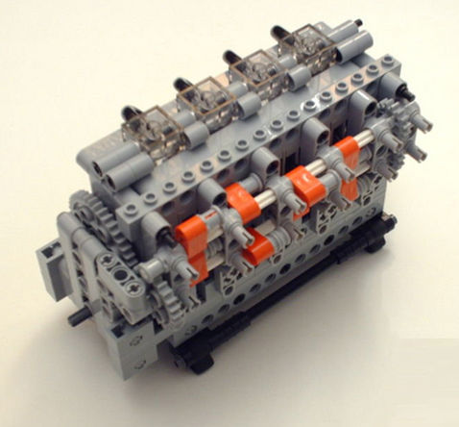
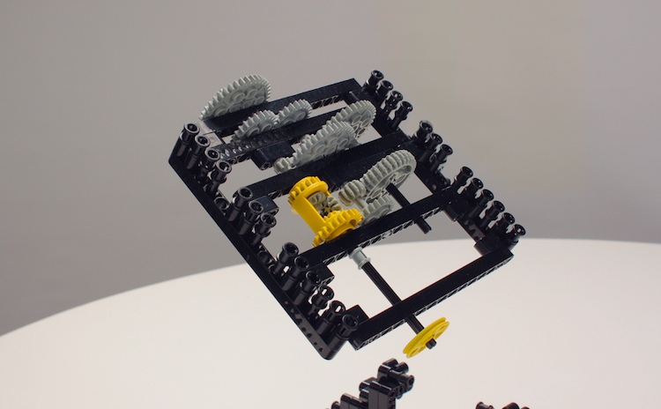
Resources
Patient
Prescription
Notes:
Readily useable, contain “the 80%” (What’s the 80%...what’s maximum reuse? That’s HL7’s core business!)
Independent of context, fixed defined behaviour and meaning
Can reference each other
Units of exchange – suggests units of storage for implementers
Addressed through HTTP or other methods

Slide 17
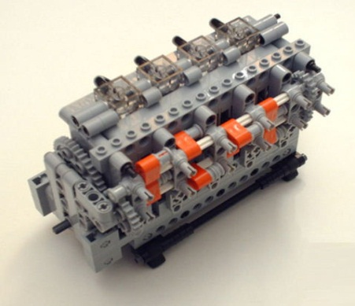
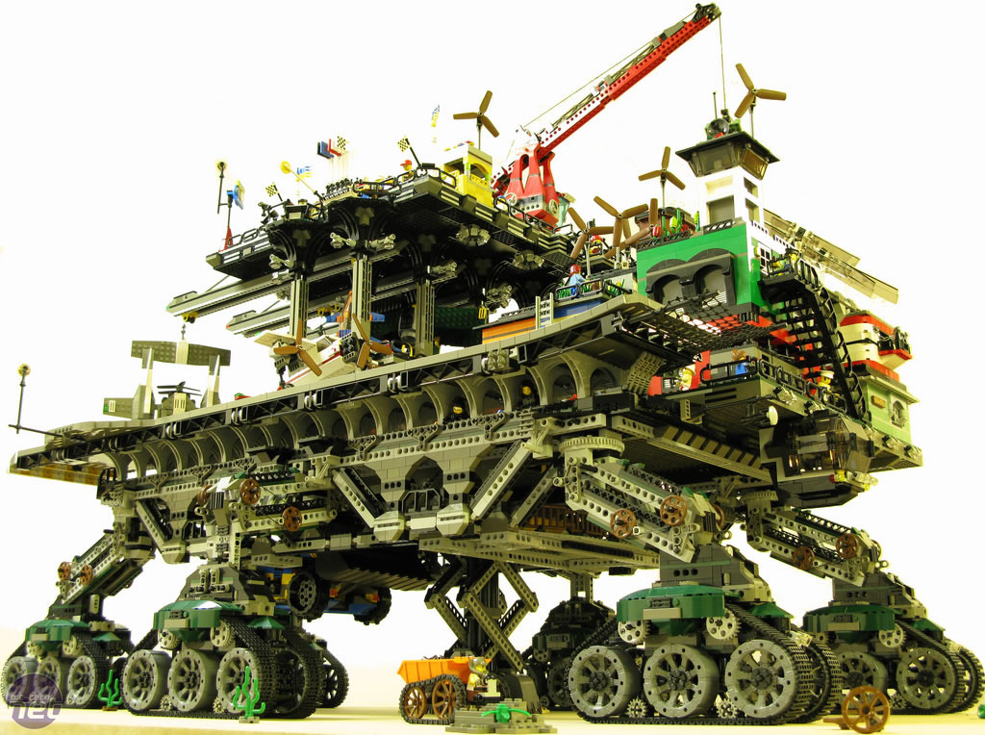
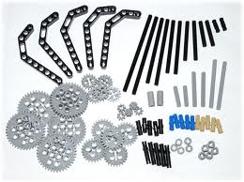
Extensibility
+
=
Notes:
You can constrain away stuff you don’t need
You can add stuff to the basic models for your usecase
“Remove and add bricks as necessary”

Slide 18
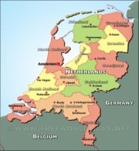


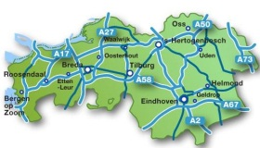


Profiles & Conformance
Notes:
“Drive-by” or “bottom-up” operability: “Communicate first, standardize later”
First, business partners. Then, collaborations, communities. Maybe, finally, nation-wide
It’s a natural process that people will want to make it work first, then only coordinate what they really need to, and then realize they can broaden their approach to a community.
“Support”, of course top-down should still be possible! Maybe even a combi in the long-term

Slide 19
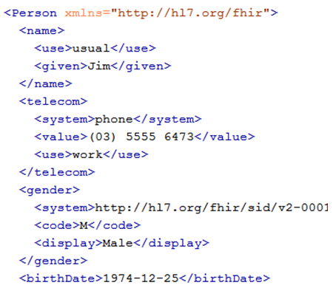

Transport
Message
Document
HTTP/1.1 200 OK
Content-Type: application/json;charset=utf-8
Content-Length: 627
Content-Location: /fhir/person/@1/history/@1
Last-Modified: Tue, 29 May 2012 23:45:32 GMT
ETag: "1“
"Person":{"id":{"value":"1"},"identifier":[{"type":{"code":"ssn","system":"http://hl7.org/fhir/sid
REST
Notes:
Document every resource, every attribute
Provide examples
Define how to use in REST, Document and Message
Manageable by a project lead in a weekend, or you’ll be ignored (in favor of local solutions)

Slide 20
FHIR Resources
Notes:
10:00

Slide 21


Resources
“Resources” are:
Small logically discrete units of exchange/storage
Defined behaviour and meaning
Known identity / location
“of interest” to healthcare
Defined by HL7 committees
About 100-150 in total
V2: Sort of like Segments,
V3: Sort of like CMETs

Slide 22
What’s a Resource?
Examples
Non-examples
Administrative
Person, Patient, Visit, Organization, Coverage, Invoice
Clinical Concepts
Allergy, Problem, Questionnaire, Care Plan
Infrastructure
Document, Message, Profile, Conformance
Gender
Too small
Electronic Health Record
Too big
Blood Pressure
Too specific
Intervention
Too broad
Notes:
And few systems will ever see more than 40-50

Slide 23
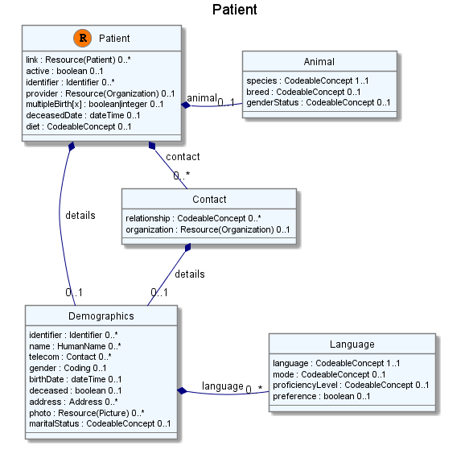
Resource diagram

Slide 24
Resource in the spec
Description (definition, scope)
UML diagram
Simple pseudo-XML syntax
Vocabulary bindings
Constraints (validation)
Notes
Search Criteria
Data dictionary
Example instance
Schema

Slide 25
Resource representation
Each resource is modeled using developer friendly XML
XML does not reflect RIM-based modeling
No classCodes, moodCodes, etc. visible
Uses a variant of the ISO datatypes
Notes:
Defined Structured Data
The logical, common contents of the resource
Mapped to formal definitions/RIM & other formats
Extensions
“Non-common” requirements, but everyone can use
Published and managed
Narrative
Human readable (fall back)

Slide 26
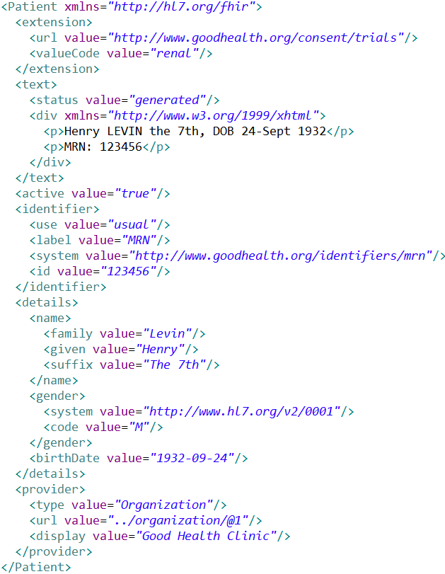
Extensions
Narrative
Defined
Structured
Data

Slide 27
FHIR Extensions
Notes:
10:15

Slide 28
The Case for Extensions
Simple choice – design for absolutely everything or allow extensions
Everyone needs extensions, everyone hates them:
Z-segments in v2
What does this mean?
ZSB|20080117|Q^57|4.30^uL
Foreign namespaces in CDA/V3
Break schemas

Slide 29
Extensions without the pain…
Extensions are not a dirty word, they will be common
Extensions are built into the wire format
All conformant systems can “handle” any possible extension - Just a bucket of “other stuff”
Framework to define, document, publish, find extensions

Slide 30
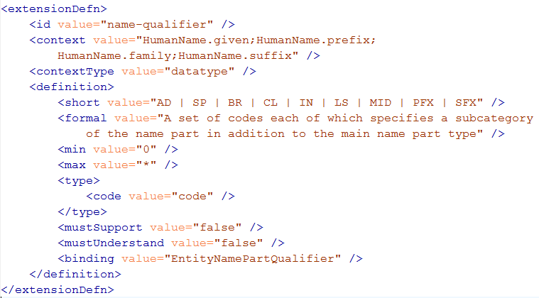
Extension definition

Slide 31
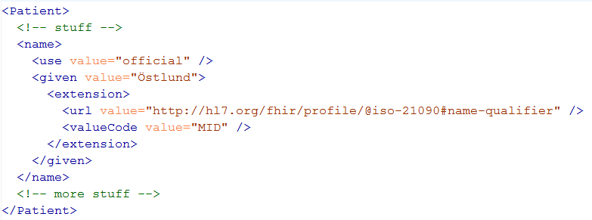
Extending a name
Key = location of formal definition
Value = value according to definition

Slide 32
FHIR PROFILES & CONFORMANCE
Notes:
10:15

Slide 33
Profiles
Defines what ‘your jurisdiction’ needs to communicate and store
Defined by HL7 Int, Country, Region, Organization, Project
Accessible on-line – via URL
Structured, computer readable, used for validation
In fact, it’s a Resource itself

Slide 34
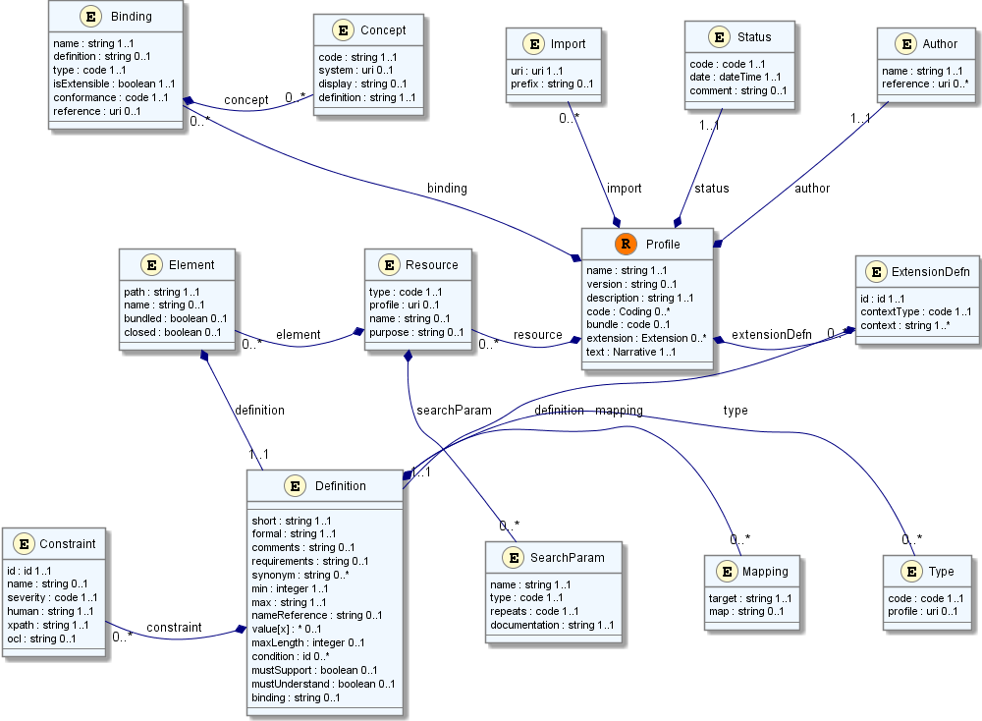
Profile (cont’d)

Slide 35
Profile contents
Constrain existing resources or profiles
Define new extensions
Define new bindings
Define messaging events, search operations
Subsumes: template, implementation profile, DCM (Detailed Clinical Model), etc.

Slide 36
Conformance
There’s a resource for documenting conformance to FHIR
Can be used for:
Stating how a specific system instance behaves
Defining how a software system is capable of behaving (including configuration options)
Identifying a desired set of behavior (e.g. RFP)
To declare themselves “FHIR Conformant”, a system must publish a Conformance instance

Slide 37
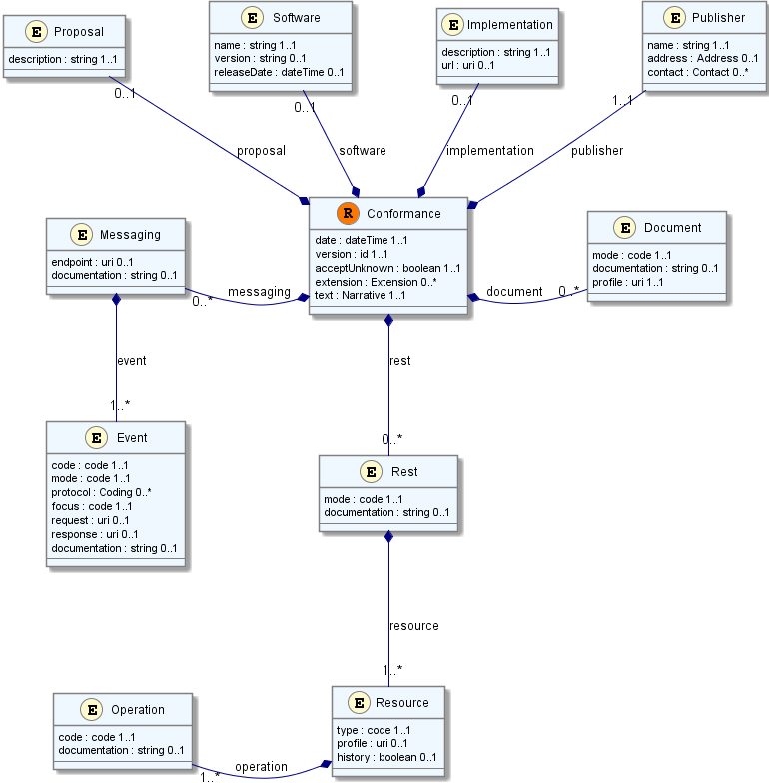
Conformance (cont’d)

Slide 38
Paradigms
FHIR supports 4 interoperability paradigms
REST
Documents
Messages
Services

Slide 39
Paradigms
Regardless of paradigm the content is the same
This means it’s straight-forward to share content across paradigms
E.g. Receive a lab result in a message. Package it in a discharge summary document
It also means constraints can be shared across paradigms
E.g. Define a profile for Blood Pressure and use it on resources in messages, documents, REST and services

Slide 40
REST
Rest
Simple, out-of-the-box interoperability
Leverage HTTP: GET, POST, etc.
Pre-defined operations
Create, Read, Update, Delete
Also: History, Read Version, Search, Updates, Validate, Conformance & Batch
Works best in environments where control resides on client side and trust relationship exists
Notes:
URLs, parameters, etc. all defined
Choice of what operations to support
Behavior documented in conformance profile - mandatory

Slide 41
Just a quick GET
GET /fhir/person/@1
HTTP/1.1 200 OK
Content-Type: text/xml+fhir;charset=utf-8
Content-Length: 787
Content-Location: http://fhir.furore.com/fhir/person/@1/history/@1
Last-Modified: Tue, 29 May 2012 23:45:32 GMT
UTF-8 encoded
<Person xmlns="http://hl7.org/fhir"><identifier><label>SSN</label> <identifier><system>http://hl7.org/fhir/sid/usssn</system><id>444222222</id> </identifier></identifier><name><use>official</use><family>Everywoman</family> <given>Eve</given></name><telecom><system>phone</system><value>555-555 2003</value> <use>work</use></telecom><gender><system>http://hl7.org/fhir/sid/v2-0001</system>
<code>F</code></gender><birthDate>1973-05-31</birthDate><address><use>home</use> <line>2222 Home Street</line></address><text><status>generated</status><div xmlns="http://www.w3.org/1999/xhtml">Everywoman, Eve. SSN:444222222</div></text></Person>
Notes:
You can retrieve any person using a GET on the person’s id, which is just an url on the server: /fhir/person/@<id>
We have our own MIME-type: “text/xml+fhir”
Note that FHIR always uses UTF-8. Since this is not the default for HTTP, the server explicitly mentions this
But should mean the xml encoding mentions “utf-8” and that the payload is really encoded in utf-8
There can be a Byte Order Mark, but hopefully your framework handles all that ;-)
The response returns a Content-Location header with a version-specific location….see next slide

Slide 42
FHIR Document
Documents
Document Resource
Similar to CDA
A point in time collection of resources, bound together
Root is a “Document” resource
Just like CDA header
One context
Can be signed, authenticated, etc.
Section
Section
Observation Resource
Device Resource
Prescription Resource
Person Resource

Slide 43
FHIR Message
Messages
Message Resource
Similar to v2 and v3 messaging: event codes, defined content for request and response.
Also a collection of resources which includes a “Message” resource, similar in purpose to Message wrapper and MSH segment
Sent as a result of some real-world event intended to accomplish a particular purpose
source
destination
event
Observation Resource
Device Resource
Person Resource
Notes:
10:30

Slide 44
Service Oriented Architecture (SOA)
Do whatever you like
(based on SOA principles)
Ultra complex workflows
Ultra simple workflows
Individual resources or collections (in Atom or other formats)
Use HTTP, email, FTP, sockets…only constraint is that you’re passing around FHIR resources in some shape or manner
Services

Slide 45
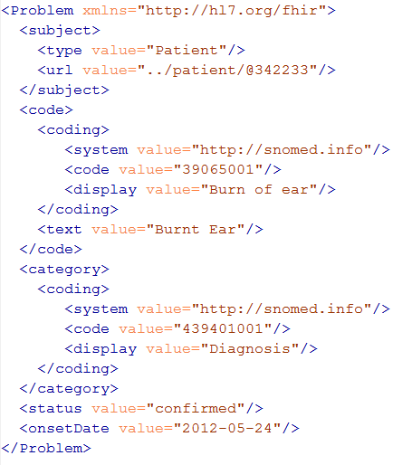
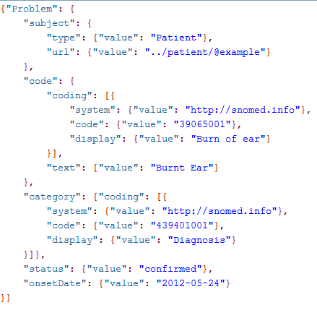
FHIR on the wire
XML
JSON

Slide 47
Resource identity and references

Slide 48
A Resource’s REST identity
In fact: an URL
http://server.org/fhir/person/@1
resource type
base path
identifier
Note: This URL resolves to the current version of a resource
Notes:
This is not only the URL you use to retrieve the resource, it’s also its id.
All URL’s in FHIR are case-sensitive (and so is the id)

Slide 49
For a specific version…
We have the version-specific URL
http://server.org/fhir/ (continued)
person/@1/history/@4
base path
resource type
identifier
version id
Notes:
Both the Resource id URL and the version-specific URL are used on many places of the REST spec and resource content (References!). They are always used consistently in this form.

Slide 50
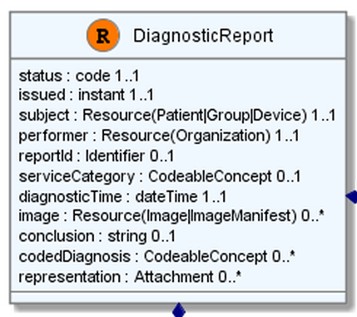
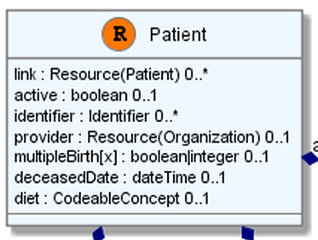
“Business” identifiers

Slide 51
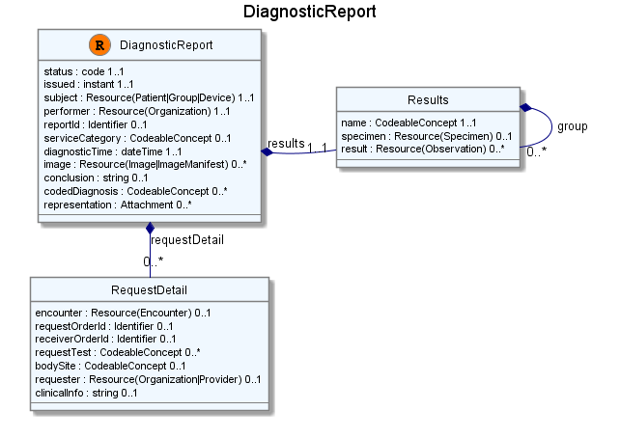
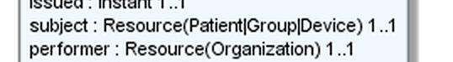
Resource Reference
“Refers to…”
Notes:
References between resources are not by “business key”, it is *not* the patient id, it’s a REST URI!

Slide 52
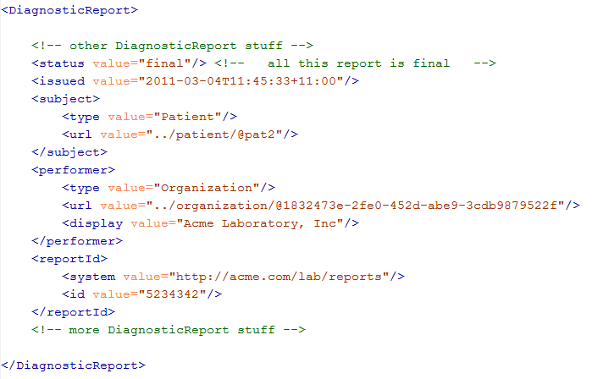
Resource Reference

Slide 53
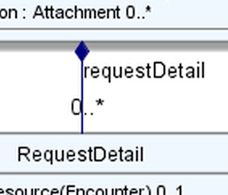
Containment
“Contains”

Slide 54
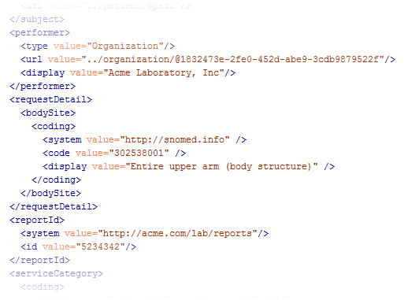
Containment

Slide 55
Bundles

Slide 56
Bundles as Atom
Operations like “search” and “history” return lists of resources
The natural way to represent lists in a Web context is using Atom feeds
Advantages:
Industry standard – platform support
Subscribe to a feed for changes (Outlook!)
Room for metadata
Notes:
http://hl7connect.healthintersections.com.au/svc/fhir/patient/search?name=every

Slide 57
Resource metadata
REST id
Version-specific reference
Last updated
Type of Resource
Author
…
Maps well to Atom Entries

Slide 58
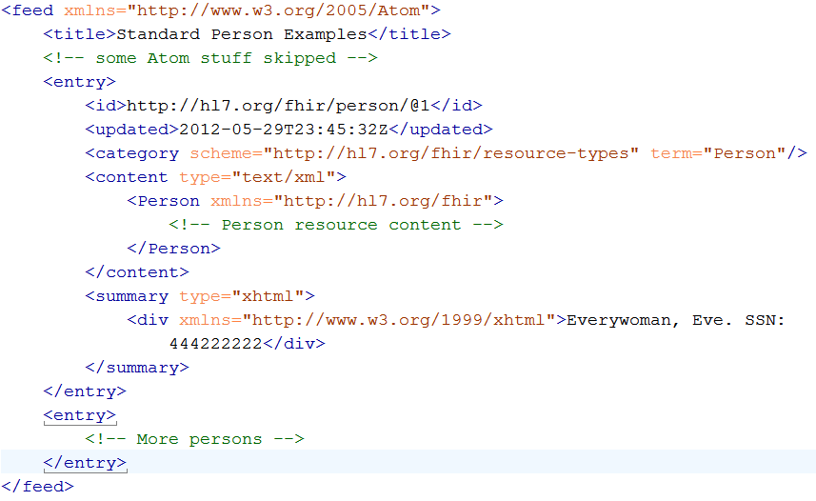
An example Bundle (Atom)
Here’s the resource’s id
Some more meta-data
1
The resource itself
Human-readable form,
just like Resource.text
2
Notes:
Note that the id of the resource is kept outside the resource itself
Atom has many other meta-data items (not shown), which we will discuss later.

Slide 59
Messages/Documents
Document Resource
Atom Feeds!
Message Resource
Section
source
destination
Section
event
Observation Resource
Observation Resource
Device Resource
Device Resource
Prescription Resource
Person Resource
Person Resource
“Flat” lists of Resources, with a Document or Message resource as the first feed entry

Slide 60
REST service interface

Slide 61
REST?
“REpresentational State Transfer”
Based on a dissertation by Roy Fielding from 2000
Roy Fielding is one of the principal authors of the Hypertext Transfer Protocol (HTTP) specification versions 1.0 and 1.1
Make systems use the “web” like humans do

Slide 62
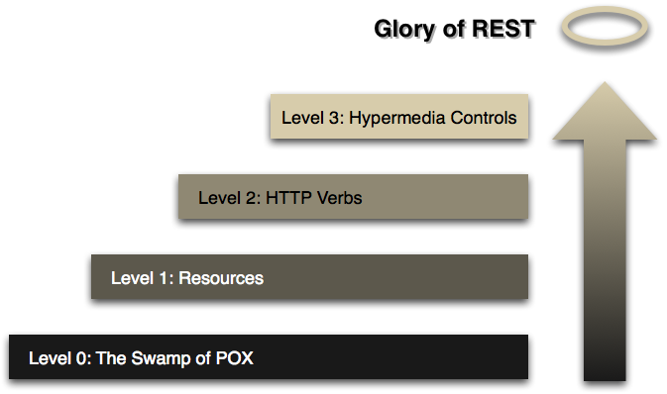
The Glory of REST
Source: http://martinfowler.com/articles/richardsonMaturityModel.html
Notes:
Richardson’s REST Maturity Model. We’re at 2.5. Fielding says: “You are not REST”, so we are “RESTful”

Slide 63
Just a quick GET
GET /fhir/person/@1
HTTP/1.1 200 OK
Content-Type: text/xml+fhir;charset=utf-8
Content-Length: 787
Content-Location: http://fhir.furore.com/fhir/person/@1/history/@1
Last-Modified: Tue, 29 May 2012 23:45:32 GMT
Verb
Header
<Person xmlns="http://hl7.org/fhir"><identifier><label>SSN</label> <identifier><system>http://hl7.org/fhir/sid/usssn</system><id>444222222</id> </identifier></identifier><name><use>official</use><family>Everywoman</family> <given>Eve</given></name><telecom><system>phone</system><value>555-555 2003</value> <use>work</use></telecom><gender><system>http://hl7.org/fhir/sid/v2-0001</system>
<code>F</code></gender><birthDate>1973-05-31</birthDate><address><use>home</use> <line>2222 Home Street</line></address><text><status>generated</status><div xmlns="http://www.w3.org/1999/xhtml">Everywoman, Eve. SSN:444222222</div></text></Person>
Body
Notes:
You can retrieve any person using a GET on the person’s id, which is just an url on the server: /fhir/person/@<id>
We have our own MIME-type: “text/xml+fhir”
Note that FHIR always uses UTF-8. Since this is not the default for HTTP, the server explicitly mentions this
But should mean the xml encoding mentions “utf-8” and that the payload is really encoded in utf-8
There can be a Byte Order Mark, but hopefully your framework handles all that ;-)
The response returns a Content-Location header with a version-specific location….see next slide

Slide 64
Instance-level ops
Read - Read the current state of the resource
GET /fhir/person/@1
VRead – Read the state of a specific version of the resource
GET /fhir/person/@1/history/@4
Update – Update an existing resource by its id (upsert)
PUT /fhir/person/@1
Delete – Delete a resource
DELETE /fhir/person/@1
History – Retrieve the update history for the resources
GET /fhir/person/@1/history
Notes:
You can retrieve any person using a GET on the person’s id, which is just an url on the server: /fhir/person/@<id>
We have our own MIME-type: “text/xml+fhir”
Note that FHIR always uses UTF-8. Since this is not the default for HTTP, the server explicitly mentions this
But should mean the xml encoding mentions “utf-8” and that the payload is really encoded in utf-8
There can be a Byte Order Mark, but hopefully your framework handles all that ;-)
The response returns a Content-Location header with a version-specific location….see next slide

Slide 65
Resource type-level ops
Create – Create a new resource with a server-assigned id
POST /fhir/person
Search – Search the resource based on some filter criteria
GET /fhir/person/search?name=x&gender=y
GET /fhir/person
History – Retrieve the update history for a particular resource type
GET /fhir/person/history?_since=xxxx
Validate – Check that the content would be acceptable as an update
POST /fhir/person/validate/@1
Notes:
You can retrieve any person using a GET on the person’s id, which is just an url on the server: /fhir/person/@<id>
We have our own MIME-type: “text/xml+fhir”
Note that FHIR always uses UTF-8. Since this is not the default for HTTP, the server explicitly mentions this
But should mean the xml encoding mentions “utf-8” and that the payload is really encoded in utf-8
There can be a Byte Order Mark, but hopefully your framework handles all that ;-)
The response returns a Content-Location header with a version-specific location….see next slide

Slide 66
Service-level ops
Conformance – Get a conformance statement for the system
GET /fhir/metadata
Batch – Update or create a set of resources
POST /fhir
History – Retrieve the update history for all resources
GET /fhir/history?_since=xxxx
Notes:
You can retrieve any person using a GET on the person’s id, which is just an url on the server: /fhir/person/@<id>
We have our own MIME-type: “text/xml+fhir”
Note that FHIR always uses UTF-8. Since this is not the default for HTTP, the server explicitly mentions this
But should mean the xml encoding mentions “utf-8” and that the payload is really encoded in utf-8
There can be a Byte Order Mark, but hopefully your framework handles all that ;-)
The response returns a Content-Location header with a version-specific location….see next slide

Slide 67
Inside the FHIR distribution

Slide 68
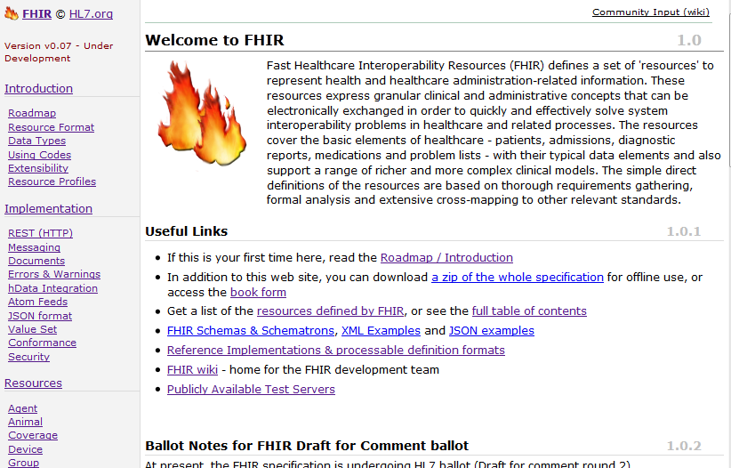
(FHIR home)
http://hl7.org/fhir
Notes:
Published as HTML
Published using validation process that performs consistency checks
Really shouldn’t require much guidance to read, but a few things to call out
Objective of spec is developer can skim and decide in < day

Slide 69
On the FHIR website
Under “Implementation”…
A zip with all schema’s + schematron to validate Xml messages
A zip with all examples (in both xml and json format).
Delphi.zip, Java.zip, CSharp.zip
The whole website (multiple html files) or book (=1 BIG html file)
Notes:
If you come to a connectathon with a FHIR server, it is a good idea to make sure you can preload your server with all the examples!

Slide 70
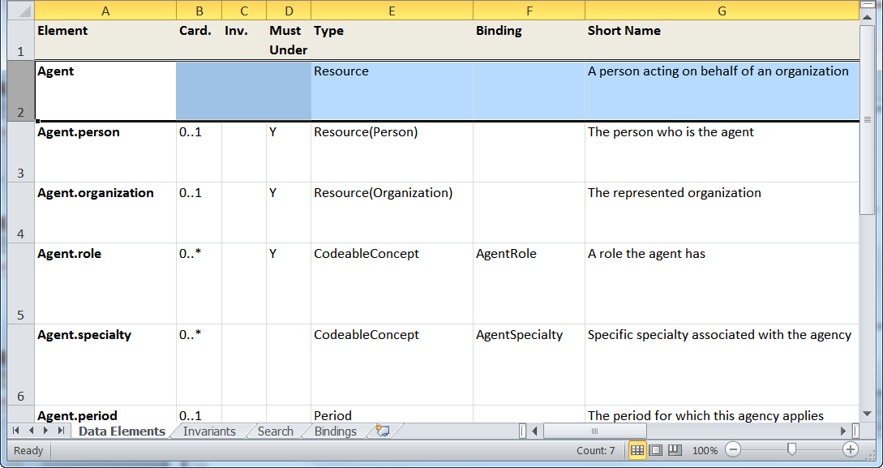
“Source” of FHIR

Slide 71


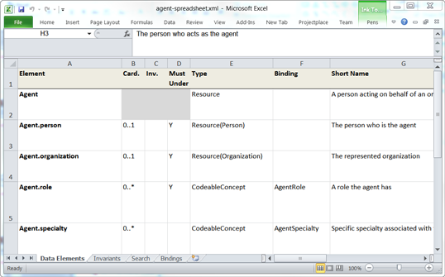


Publication process
.INI
Publication tool
(org.hl7.fhir.tools.jar)
Website
Examples
Resource
UML
Java, C#,
Delphi
Validation
Schema’s
DictXml
Resource profiles
eCoreDefinitions.xml

Slide 72
In the FHIR SVN
http://gforge.hl7.org/svn/fhir/trunk
All presentations (/presentations)
All Resource source files (Excel) (/source)
Source of the publication process (/tools)
Archived older versions of FHIR (/archive)
Help extend generation, use eCoreDefinitions (/publish)
We use Eclipse + Java 1.6

Slide 73
Building with FHIR

Slide 74
Some possible uses
v3
App
v2
FHIR
PHR
FHIR
Broker
Comm.
Interface
FHIR
DB
Notes:
You’re a message broker routing and translating between v2, v3 and FHIR
Your app interfaces with a PHR using FHIR natively
Your application can communicate using FHIR, but your software uses a proprietary RDBMS
Use FHIR as the common language for a Vendor Neutral Archive
…Or a combination….
You might see data as a nested structure of XML, a series of tables with keys, class-diagrams….

Slide 75
Repository model
HIS
LIMS
PACS
SystemX
Gateway
FHIR
FHIR
FHIR
FHIR
FHIR
Vendor Neutral Repository

Slide 76
Reference implementations
√
App
Get data from UI in/out of an Object model
Manipulate Object model
√
FHIR
Serialize object model to FHIR XML or Json
Use HTTP API to send data to server
Use a REST framework to receive calls
√
Deserialize XML or Json or
Deserialize XML or Json into Object model
PHR
Store Object model in a database

Slide 77
Object Model
[FhirResource("DiagnosticReport")]
public partial class DiagnosticReport : Resource
{
public Code<ObservationStatus> Status {…}
public Instant Issued {…}
public ResourceReference Subject {…}
public ResourceReference Performer {…}
public Identifier ReportId {… }
public
List<DiagnosticReportRequestDetailComponent> RequestDetail { …}

Slide 78
Serializing…
Patient ewout = new Patient();
ewout.Details.Name
.Add(HumanName.ForFamily("Kramer")
.WithGiven("Ewout"));
string jsonEwout = FhirSerializer.SerializeResourceAsJson(p);
and ofcourse:
Patient ewout = FhirParser.ParseResourceFromJson(jsonEwout);

Slide 79
Communicating
FhirClient client = new FhirClient(new
Uri("http://fhir.someendpoint.com/svc/fhir"));
Patient ewout = client.Read<Patient>("1");
ewout.Details.Name
.Add(HumanName.ForFamily("Kramer")
.WithGiven("Ewout"));
ewout = client.Update<Patient>(ewout, "1");

Slide 80
What’s next?

Slide 81
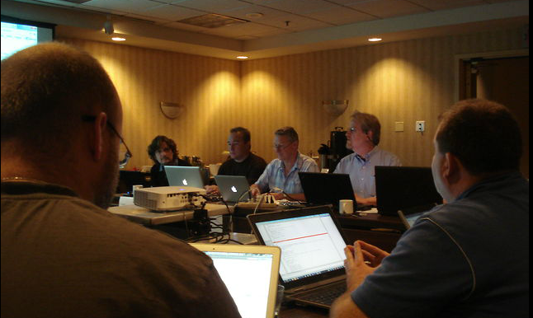
Some history…
September 2011 First “preview” version of FHIR called
Resources for Health
September 2012 First draft for comment ballot
Focus on infrastructure
January 2013 Second draft for comment ballot
First content resources by PA & Pharmacy

Slide 82
Balloting plans
Next cycle will be first Draft Standard for Trial Use ballot (DSTU)
Will likely take ~1 year to complete that process
Will provide a semi-stable platform for implementers while still allowing non-backward-compatible change for Normative version if implementation experience dictates
Normative is probably 3+ years out
We want *lots* of implementation experience before committing to backward compatibility

Slide 83
Development plans
Address issues coming out of this ballot cycle
>700 comments raised
Add in many more clinical resources
Hope to have full support for C-CDA for DSTU
Additional resources will continue to be introduced in future DSTU cycles as implementers identify needs
Continue to seek testing & real world implementation experience

Slide 84

Next Steps for you
Attend the FHIR Implementers tutorial
Read the spec: http://hl7.org/fhir
Comment on the wiki (link from FHIR spec)
Join the FHIR email list http://wiki.hl7.org/index.php?title=FHIR_email_list_subscription_instructions
Follow #FHIR on Twitter
Make Ballot comments
Try implementing it
Come to a Connectathon!

